Slide 1
Data Partitioning
Pravin Y Pawar
Adapted from Microsoft “Data partitioning guidance”

Slide 2
Data partitioning guidance
In many large-scale solutions, data is divided into partitions
can be managed and accessed separately
Partitioning can
improve scalability,
reduce contention,
and optimize performance
Can also provide a mechanism for dividing data by usage pattern
can archive older data in cheaper data storage
However, the partitioning strategy must be chosen carefully to maximize the benefits while minimizing adverse effects

Slide 3
Why partition data?
Reasons
Improve scalability
When a single database system scaled up, it will eventually reach a physical hardware limit
If data is divided across multiple partitions, each hosted on a separate server, can scale out the system almost
indefinitely
Improve performance
Data access operations on each partition take place over a smaller volume of data
Correctly done, partitioning can make system more efficient
Operations that affect more than one partition can run in parallel
Improve availability
Separating data across multiple servers avoids a single point of failure
If one instance fails, only the data in that partition is unavailable, operations on other partitions can continue
Improve security
In some cases, sensitive and non-sensitive data can be separated into different partitions and apply different
security controls to the sensitive data

Slide 4
Designing partitions
Three typical strategies for partitioning data
Horizontal partitioning (aka sharding)
each partition is a separate data store, but all partitions have the same schema
each partition is known as a shard and holds a specific subset of the data
such as all the orders for a specific set of customers
Vertical partitioning
each partition holds a subset of the fields for items in the data store
fields are divided according to their pattern of use
frequently accessed fields might be placed in one vertical partition and less frequently accessed fields in another
Functional partitioning
data is aggregated according to how it is used by each bounded context in the system
an e-commerce system might store invoice data in one partition and product inventory data in another
These strategies can be combined
might divide data into shards and then use vertical partitioning to further subdivide the data in each shard

Slide 5
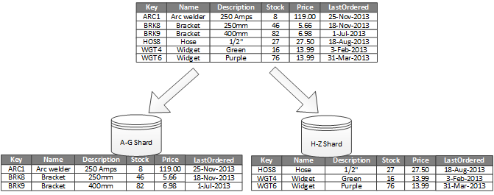

Horizontal partitioning (sharding)
Example Product data
Product inventory data is divided into shards based on the product key
Each shard
holds the data for a contiguous range of shard keys (A-G and H-Z) organized alphabetically
Sharding spreads the load over more computers, which reduces contention and improves performance.

Slide 6
Horizontal partitioning (sharding) - 2
Practices
Sharding key
most important factor is the choice of a sharding key
can be difficult to change the key after the system is in operation
key must ensure that data is partitioned to spread the workload as evenly as possible across the shards
Choose a sharding key that minimizes any future requirements to split large shards, coalesce small shards into larger partitions,
Changing the schema can be very time consuming, and might require taking one or more shards offline while they are performed
Size
The shards don't have to be the same size
more important to balance the number of requests
Some shards might be very large, but each item has a low number of access operations
Other shards might be smaller, but each item is accessed much more frequently
Access
Avoid creating "hot" partitions that can affect performance and availability
using the first letter of a customer's name causes an unbalanced distribution, because some letters are more common
instead, use a hash of a customer identifier to distribute data more evenly across partitions
Replication
If shards are replicated, it might be possible to keep some of the replicas online while others are split, merged, or reconfigured
the system might need to limit the operations that can be performed during the reconfiguration
the data in the replicas might be marked as read-only to prevent data inconsistences

Slide 7
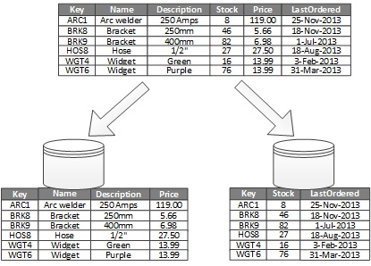
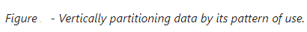
Vertical partitioning
Example of vertical partitioning
Different properties of an item are stored in different partitions
One partition holds data that is accessed more frequently, including product name, description, and price
Another partition holds inventory data: the stock count and last-ordered date

Slide 8
Vertical partitioning (2)
Advantages
The most common use is to reduce the I/O and performance costs associated with fetching items that are frequently accessed
Vertical partitioning operates at the entity level within a data store,
partially normalizing an entity to break it down from a wide item to a set of narrow items
ideally suited for column-oriented data stores such as HBase and Cassandra
Relatively slow-moving data (product name, description, and price) can be separated from the more dynamic data (stock level and last ordered date)
Slow moving data is a good candidate for an application to cache in memory
Sensitive data can be stored in a separate partition with additional security controls
Vertical partitioning can reduce the amount of concurrent access that's needed

Slide 9
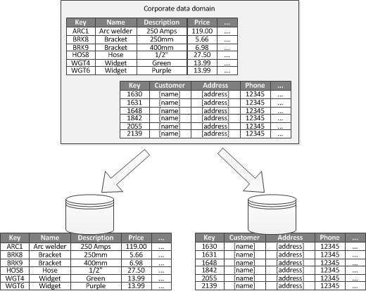

Functional partitioning
Functional partitioning is a way to improve isolation and data access performance
suitable when possible to identify a bounded context for each distinct business area in an application
can be used to separate read-write data from read-only data
can help reduce data access contention across different parts of a system

Slide 10
Rebalancing partitions
As a system matures, need to adjust the partitioning scheme!
For example,
individual partitions might start getting a disproportionate volume of traffic and become hot, leading to excessive contention
might have underestimated the volume of data in some partitions, causing some partitions to approach capacity limits
Some data stores, such as Azure Cosmos DB, can automatically rebalance partitions
In other cases, rebalancing is an administrative task that consists of two stages:
Determine a new partitioning strategy.
Which partitions need to be split (or possibly combined)?
What is the new partition key?
Migrate data from the old partitioning scheme to the new set of partitions.
Migrations
Depending on the data store, might be able to migrate data between partitions while they are in use - online migration
If that's not possible, might need to make partitions unavailable while the data is relocated - offline migration

Slide 11
Rebalancing partitions
Migrations
Offline migration
is typically simpler because it reduces the chances of contention occurring
Works as follows:
Mark the partition offline
Split-merge and move the data to the new partitions
Verify the data
Bring the new partitions online
Remove the old partition
Optionally, you can mark a partition as read-only in step 1, so that applications can still read the data while it is being moved
Online migration
more complex to perform but less disruptive
similar to offline migration, except the original partition is not marked offline
Depending on the granularity of the migration process, the data access code in the client applications
might have to handle reading and writing data that's held in two locations, the original partition and the new
partition

Slide 12
Thank You!
In our next session:

